Slide 1

Assessment 1b: Use Case + Activity Diagrams
Alex Rush
23140056
Foundations of Programming

Slide 2
Case Study Outline – Proposed Mobile App Solution
My partner can never ever decide what we should make to eat so I've made an app to randomly select a recipe from a database using preferences/allergies and you can keep hitting the next recipe button till you find something that you might enjoy making.
You can then order everything you need through the app using Uber/Deliveroo type services ticking or unticking what you might already have that you don't need to order extra for.
You can then pay for and track the delivery or if you want to save money just take the recipe and go shopping yourself by saving it to favorites.

Slide 3
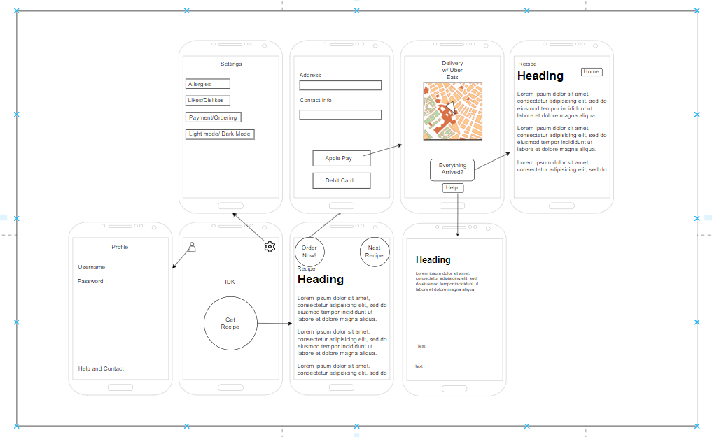

Slide 4
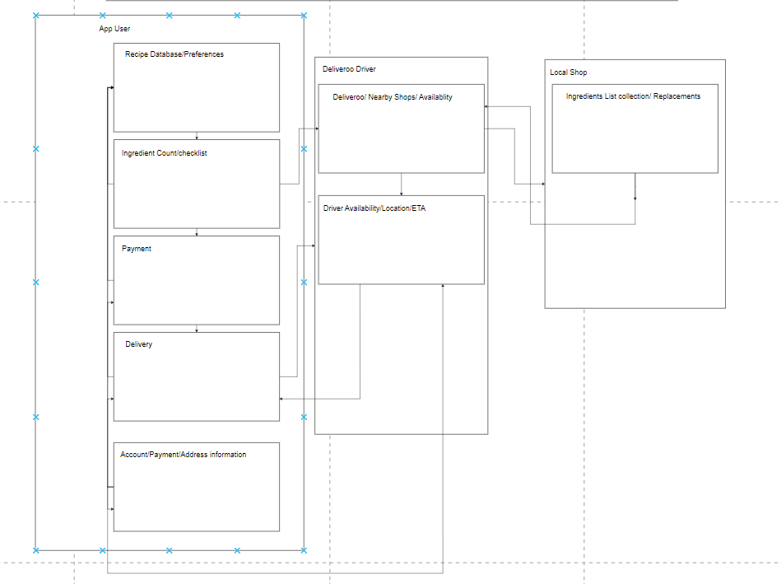
Activity Diagram

Slide 5
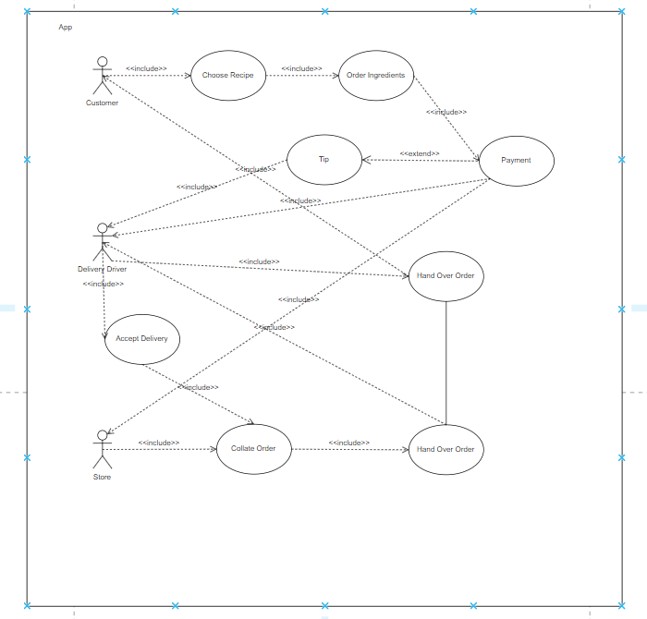
Use Case

